Slide 1

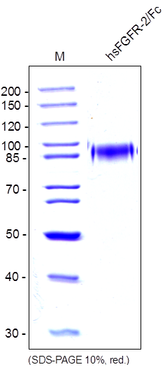
ReliaTech GmbH
Recombinant human sFGFR-2(IIIc)/Fc Chimera
(Cat #SFC-017 / SFC-018 )
Fig. 1: SDS-PAGE analysis of recombinant human soluble FGFR-2(IIIc)/Fc Chimera produced in insect cells. Sample was loaded in 10% SDS-polyacrylamide gel under reducing conditions and stained with Coomassie blue.
http://www.reliatech.de / orders@reliatech.de

